Slide 1



Best Practice Interview Training
Empowering Confident, Inclusive and Effective Interviewing at Thalia

Slide 2
Session Topics
Why this training
Purpose of an interview
Unconscious Bias
Thalia’s inclusion initiatives
9 protected characteristics
Reasonable adjustments
Effective questioning techniques
Body language and candidate experience
Interviewing planning and note taking
Mock Interviews: Hands on practice
Notes:
These are the key topics we will be covering – ask if there are any specific challenges that they need support with.
More detailed timetable can be located – PAGE 6 WORBOOKS
The day is divided into two halves AM – we will cover the underpinning knowledge and content related to interviewing and in the afternoon we will conduct mock interviews to allow you to put into practice the skills you have learned. You will be paired with one other participant as joint interviewers so will need to work together.

Slide 3

Why this training
Notes:
9.45
PAGE 4 WORK BOOKS:
Initially, the job interview can seem like a simple enough meeting to conduct: shake hands, make small talk, ask questions, and compare the candidates. But how do you keep from hiring someone whose best skill is coming off well in a job interview?
Many experts estimate that the cost of a bad hire exceeds the annual salary of a position. SO GETTING IT RIGHT IS VERY IMPORTANT
Complete in small groups and feed back to the whole fill in on page 4 – share –
( click to play Annie Lennox- Why)
Go over Overall AIMS/ OBJECTIVES on page 5 COMPARE TO RESPONSES TO THE ABOVE

Slide 4
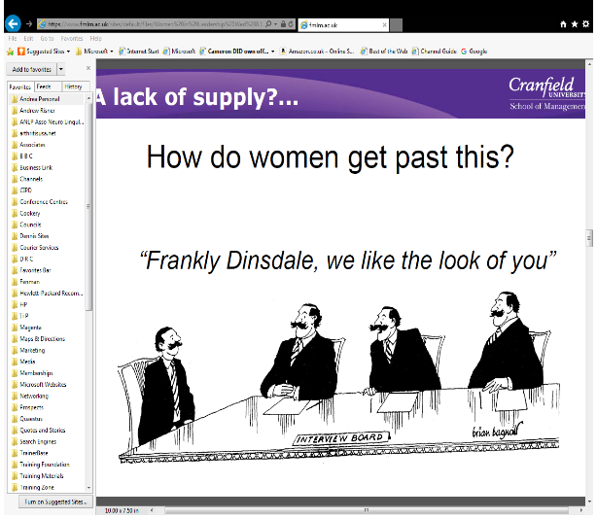
Unconscious
Bias
Notes:
11.15
Refer back to the presession tasks –
Ask group for their definition write in WB PAGE 13
All individuals, including you in your role as a line manager, make unconscious choices that discriminate in favour of, or against, certain characteristics in a person or a group. As a result of these unconscious biases, processes such as recruitment, promotion, work allocation, performance reviews and redundancies are not conducted in a fair or consistent manner.
By acknowledging and addressing the unconscious biases that you, or others, have, you are helping to create an organisation that attracts, retains and nurtures the right skills irrespective of any differences, visible or invisible.
Think about
about the time when you briefly reacted when you read a name on a resume that was culturally or ethnically different than your own,
or about the time you were aware of the subtle impulse to call Jamal back for an interview but not Joseph or Jose
or how you scanned the resume to see what year Mary graduated from high school in an attempt to guesstimate her age,
or how you felt when you interviewed a candidate whose physical appearance was different than your own, such as they were short, or obese or in a wheelchair for example,
or more significantly how you felt when you interviewed a candidate whose physical appearance met your preference of attractiveness or was your mirror image
Types:
Affinity Bias. ...
Ageism. ...
Attribution Bias. ...
Beauty Bias. ...
Confirmation Bias. ...
Conformity Bias. ...
The Contrast Effect. ...
Gender Bias.
Halo/horns
Unfortunately, unconscious bias isn’t necessarily something we can change easily — it is, after all, unconscious. Being aware of our bias’s is the best way to reduce/ overcome them

Slide 5

Notes:
Unconscious bias – stop at 9.03
Unconscious bias is a prevalent factor driving culture, causing us all to make assumptions based on our own upbringings and influences. Such implicit prejudice affects everything, and it's time for us to be more thoughtful, smarter, better. In this funny, honest talk, Yassmin Abdel-Magied uses a surprising way to challenge us all to look beyond our initial perceptions.
How does this relate to you? How does this relate to how you conduct job interviews?
We have to be a part of the solution?
See further resource in back of workbook - 11 Harmful Types of Unconscious Bias and How to Interrupt Them (Blog Post)

Slide 6
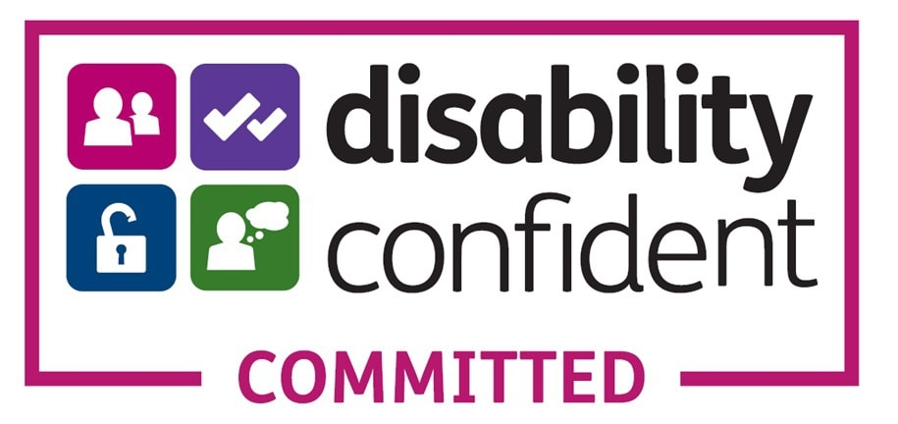

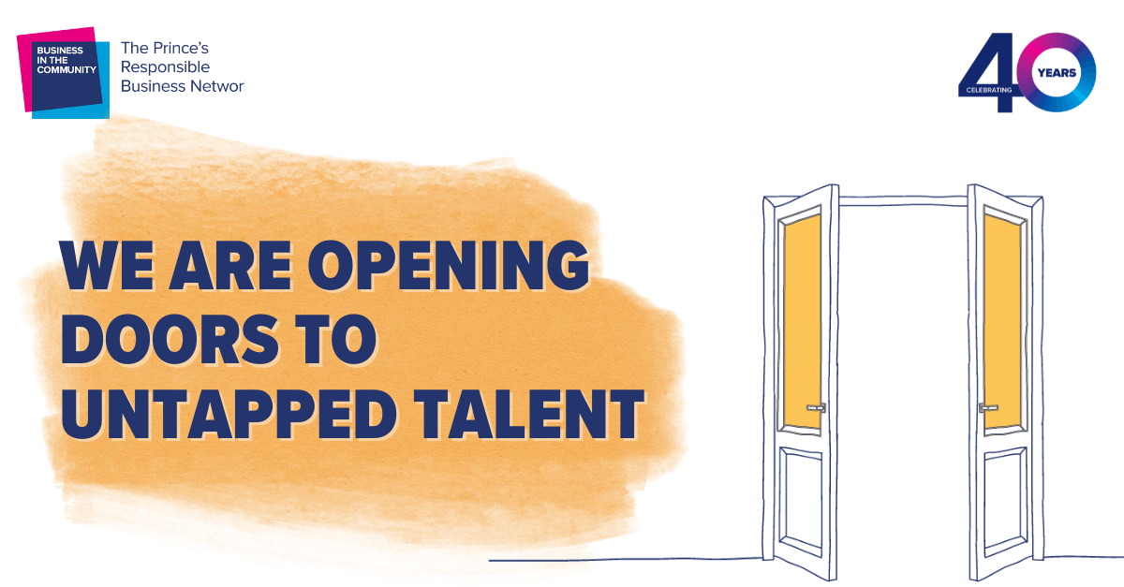

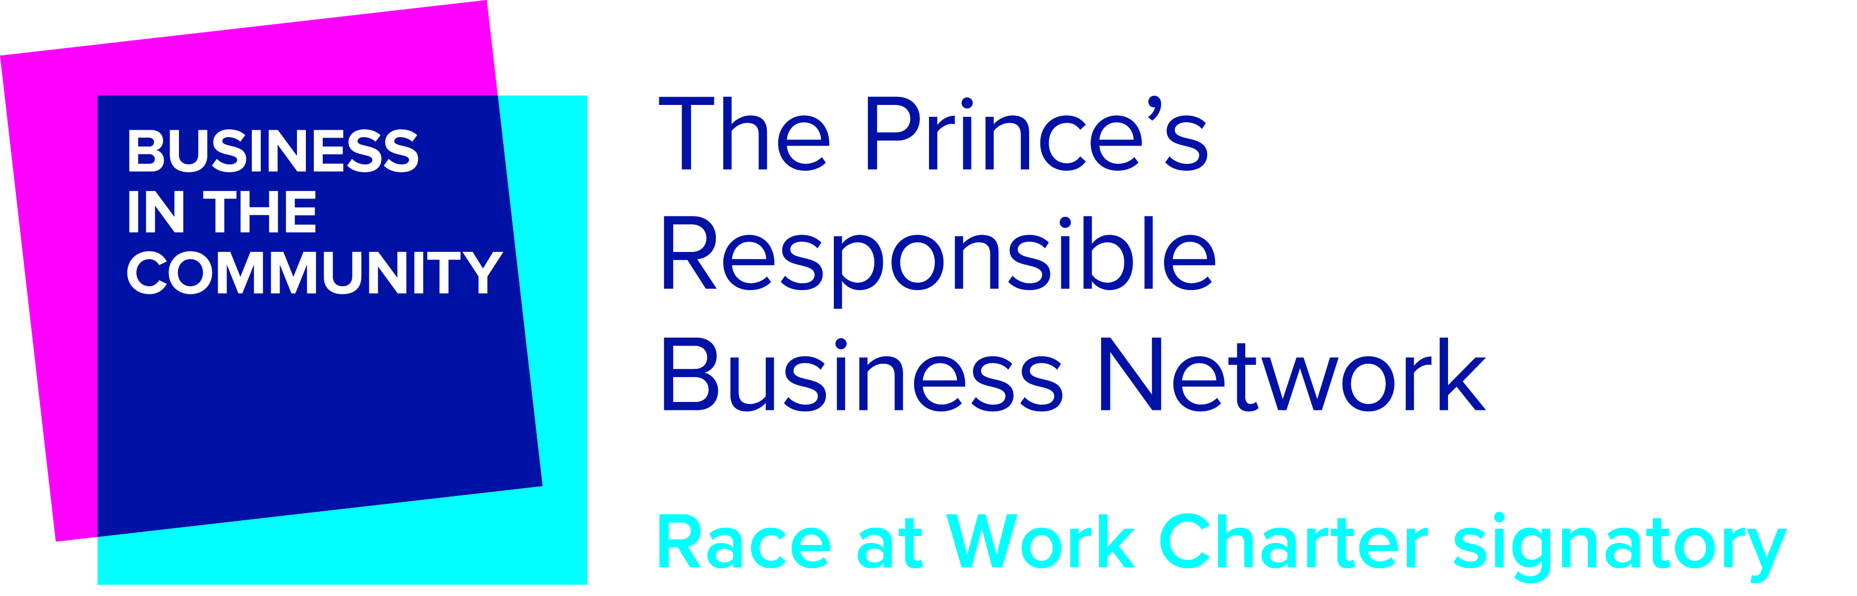


Notes:
Disability Confident is encouraging employers to think differently about disability and take action to improve how they recruit, retain and develop disabled people.
We believe that being Disability Confident is a unique opportunity to encourage people with disabilities to apply for roles, and you might just discover someone your business cannot do without.
The Disability Confident scheme supports employers to make the most of the talents disabled people can bring to your workplace.
Disability Confident employers of all sizes are:
challenging attitudes towards disability
increasing understanding of disability
removing barriers to disabled people and those with long-term health conditions
ensuring that disabled people have the opportunities to fulfil their potential and realise their aspirations
THIS DIRECTLY CORRALATES TO ONE OF OUR VALUES - INCLUSIVE
The scheme has 3 levels – L1 – Committed L2 Employer , L3 Leader. You must complete each level before moving on to the next. Thalia is currently at the Committed level
Additional resources - page 22 in WB

Slide 7
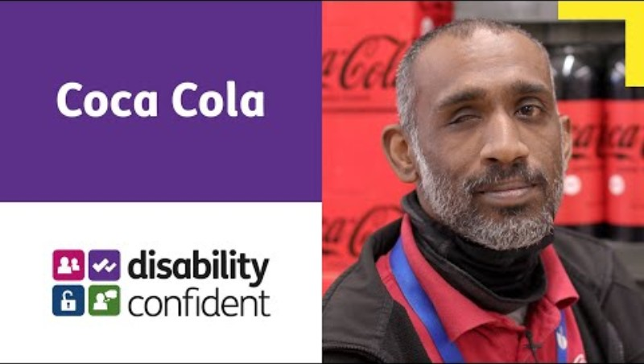
Notes:
Spotlight on Disability confident Box – 3 mins Make notes in workbooks page 8.

Slide 8

Why Recruit Ex-Offenders?
The Cost of Reoffending: Reoffending costs the UK economy £18 billion annually, reoffending rates are sitting at 39% within the first year of release and 75% within nine years . Supporting individuals in finding stable work is one of the most effective ways to reduce this burden and create safer communities.
Employment Changes Lives: Studies show that securing a job significantly reduces the likelihood of reoffending. By providing work opportunities, we’re not only offering people a fresh start but helping them support their families, rebuild their lives, and contribute to society.
Proven Success: Companies like Timpsons, Virgin Rail, Pret and DHL have seen remarkable results with similar initiatives, and we’re proud to follow in their footsteps.
80% of employers of ex-offenders positively rate their reliability, motivation, attendance, and performance
Companies that Ban the Box: Amey, Asda, Costain, Kier, Lloyds, LNER, MK College, Serco, Sodexo, Thames Water, Urbaser, Veolia, Virgin Trains, Viridor, Wincanton
Notes:
Sources –
HMP Ford inspection
https://www.timpson-group.co.uk/timpson-foundation/release-temporary-licence-rotl/

Slide 9

Test your knowledge
Notes:
Page 10 wb -Delegates to assess existing knowledge by completing the questionnaire – each candidate to individually complete the questionnaire – review responses and correct answers 10 questions Review answers
https://ukrecruiter.co.uk/2015/06/19/are-you-an-accidental-discriminator-quiz/
The term "discrimination" is used as part of everyday speech, but it has a very specific legal meaning. In a legal context, discrimination occurs only when the treatment is because of a protected characteristic. Bad or less favourable treatment is not discrimination if it is not connected to a protected characteristic.

Slide 10
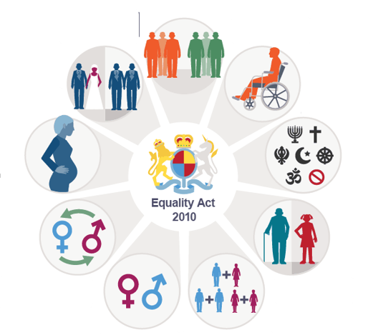
9 Protected Characteristics
Notes:
10.34 The Equality Act was introduced in the UK to eliminate unlawful discrimination, advance equal opportunities and promote good relations between people. All workplaces must comply with the Act and must be seen to be actively promoting equality and diversity amongst employees. More specifically, the Act offers protection to people with one or more of nine specific ‘protected characteristics. This means that you cannot discriminate against a person based on any of these traits. The Equal Pay Act of 1970 has largely been replaced by the Equality Act.
There are 9 protected characteristics – complete the diagram below by labelling each of the 9 characteristics.
Delegates to complete the 9 characteristics on PAGE 11 IN WB
Next slide gives the answers in ACAS video

Slide 11
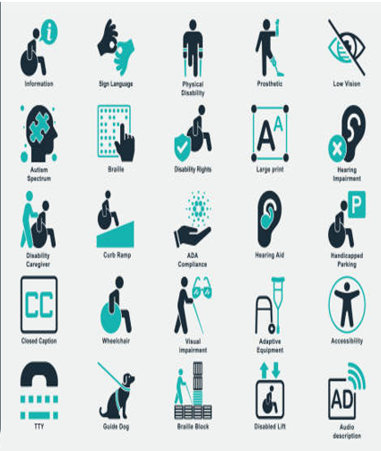
Consider some examples: Reasonable Adjustments
Notes:
Write a definition in WB page 12.Definition of "reasonable adjustment": Any step or steps an employer can reasonably take to prevent any provision, criterion or practice, or any physical feature of its premises, from putting a disabled person at a disadvantage in comparison with a non-disabled person.
The duty to make reasonable adjustments arises only where an employer knows, or reasonably ought to know, that the employee is disabled.
A failure to comply with the duty to make reasonable adjustments amounts to discrimination under s.21 of the Equality Act 2010.
Do not ask questions about a candidate's health or disability before offering them employment,
What is considered reasonable depends largely on the situation. However, if you are in doubt about whether an adjustment is reasonable, consider the following factors:
Will it reduce the employee’s disadvantage due to their disability?
Is it practical to perform?
Is it affordable to perform?
Could it harm other employees?
If you’re still unsure whether an adjustment is reasonable, it is advisable to seek legal advice on the subject.
Pairwork: consider some reasonable adjustments wb page 12
Adjustments can be physical – chairs, keyboards voice recognition software
Changing work patterns
Additional support – eg a reader

Slide 12

What does a good interview look like?
Notes:
10.48
Page 13
Remember that guidance is always available form Lisa and Niamh who can advise and suggest.
Signpost to resources page 22- How to Provide a positive user experience
If you’ve never conducted a job interview, think about the interviews you’ve experienced from the applicant’s side of the table. What worked and what didn’t? Did anything make you feel uncomfortable? Putting yourself into the applicant’s seat can help you become a more empathetic interviewer.
Remember that a poor experience could find its way onto social media before the disgruntled candidate is even back at home.
Working in groups delegates to make a list on page in of what they believe makes for a good interview. Workbooks PAGE 13
The best interviewers have three qualities in common: they prepare well, have good communication skills, and are good at assessing candidates based on the needs of the company.
Well prepared – have read cv – check the jd – prepared questions – score card for making notes - Refresh your knowledge of your company’s mission and structure, as well as the benefits and perks for the position you’re hiring for. Identify any specifics you want to clarify
Structured/ methodical - Unstructured interviews (that feel like free-flowing conversations that lack an agenda) can easily become subjective and non-job-related. Unstructured interviews help candidates feel more comfortable, but they don’t result in the best hiring decisions. Adding some structure to your interviews will make them more effective.
Questions – pre prepared - Generic interview questions (like “what’s your greatest weakness?”) are overused and brain teasers are ineffective. Prepare a short list of questions tailored to the role you’re hiring for. More on questions later
Note taking - Use effective note-taking techniques one methos you may want to try is the Cornell method*. Be sure to focus on candidates’ answers, instead of your judgements (for example, write “he told us he hasn’t dealt with difficult customers before” instead of “he’s inexperienced.”)
Consistent scoring
Show you care- Caring about candidates makes for good candidate experience and boosts your employer brand. Even if a candidate doesn’t get a job offer, they may still feel good about a company that treated them well.

Slide 13

Mastering the art of effective questioning
Notes:
11.20 WORKBOOK Page 14 – HAND OUT COMPETENCY INTERVIEW GUIDE
ASKING:
Be clear and concise
Avoid jargon
Ensure questions that can be answered with a simple ‘yes’ or ‘no’ are used only for affirmation of facts
Avoid questions that point to a right answer – leading questions
Avoid adding excessive detail
Don’t try to assess anything non-job related (especially protected characteristics)
Ask someone who wasn’t involved in writing the questions to review them
Avoid multi-layered questions
Check questions with HR for legality
Think about a great opening question that will put the candidate at ease/ build rapport
How many questions?
Interview questions should be job-related. Each question should link to a specific job requirement.
Hand out the Thalia Competency Interview Guide – explain that this will be useful for planning Mock interviews in the afternoon
ANSWERING
WORKBOOK PAGE 15 :When answering qs remember: The golden rule if you are asked a question to which you do not know the answer is to say so … never be tempted to guess!

Slide 14

Mock Interviews
Notes:
Mock interviews – Job description
Outline format and timetable for the interviews- WORKING IN PAIRS WITH ANOTHER PARTICIPANT AS THE CANDIDATE – 20min interview
You will be provided with a script for a job role: Your task is to:
Choose suitable questions from the question bank – at the end of the Competency Interview Guide
Co ordinate who is going to ask which questions
Craft a suitable opening question
Ask some probing type questions to get more information from your candidate.

Slide 15

Notes:
Test your knowledge … instruct participants to join using their phones –
https://create.kahoot.it/details/b935346d-e011-41ce-97a7-4948e2b603fe

Slide 16
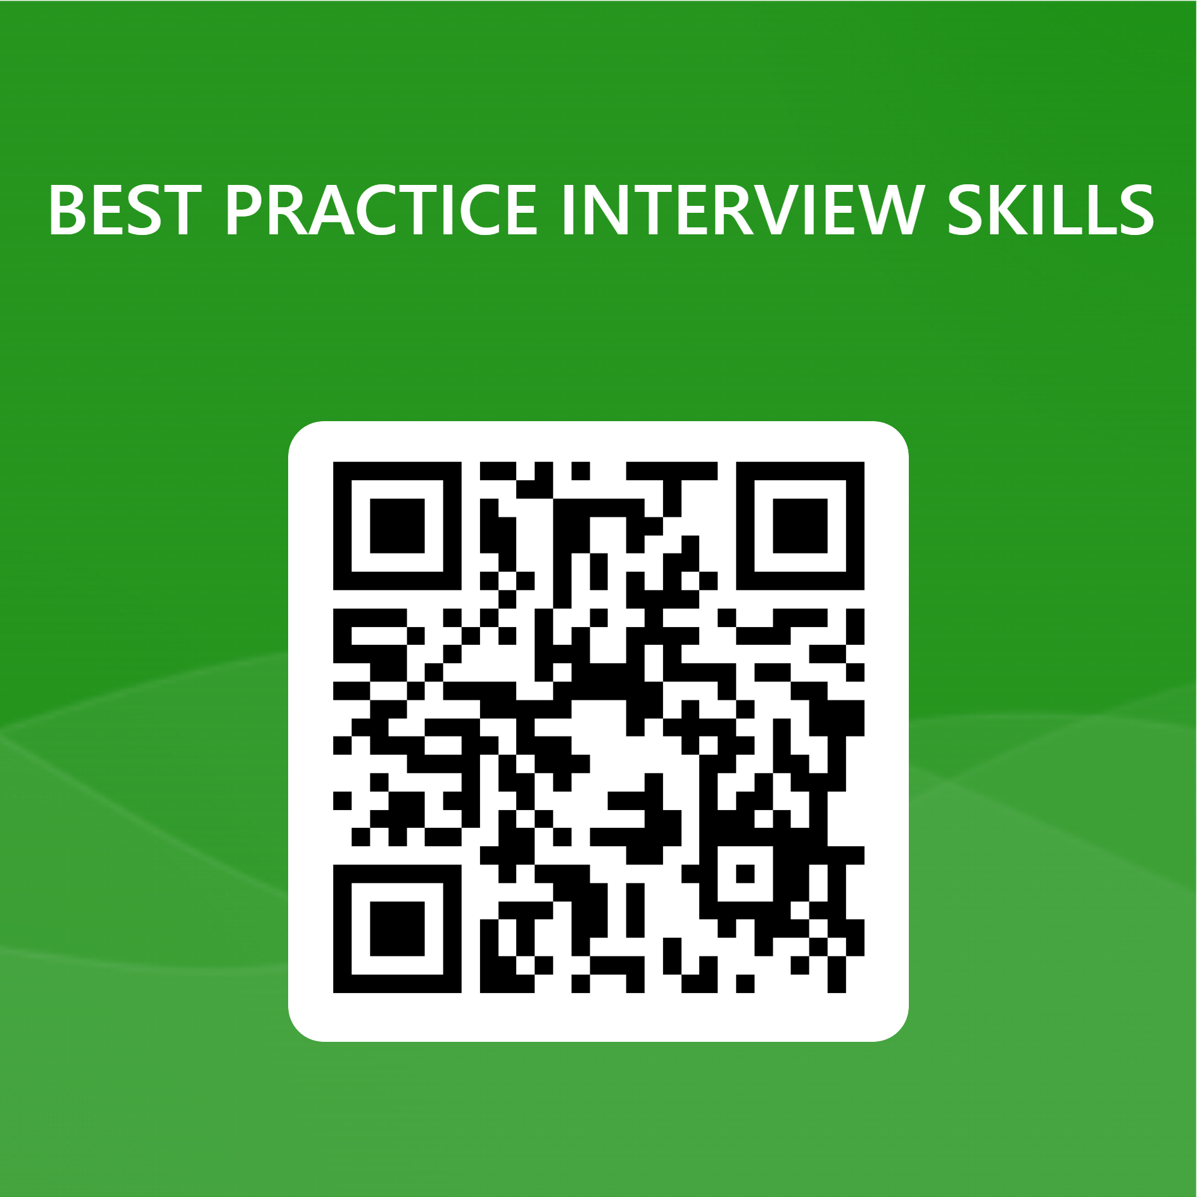

Tell us what you think
Notes:
Encourage candidates to leave feedback using QR CODE or Email link
https://forms.office.com/e/zL5XiBSuZm

